Slide 1
Bank Security
Shift-left Security: More than just a catchphrase
Vince King
January 2023
Notes:
Shift-left Security: More than just a catchphrase
Vulnerabilities like Log4j may be headline grabbers, but thousands of applications are being targeted by hackers who use flaws in code as attack vectors. Vulnerabilities such as cross-site scripting or improper authorisation are on the increase, and with the increased use of open source software we need to ensure "shift-left security" is more than just a catchphrase.
During this presentation we'll look at:
- what modern development looks like
- what developers want
- what developers actually need
- where does security fit into to all this "agile" working?

Slide 2






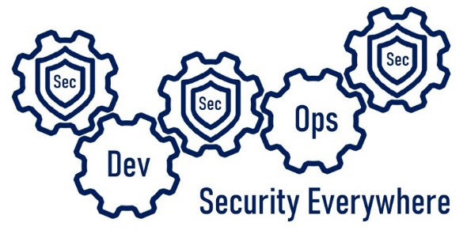

Who’s this talking to me now?
Vincent King
Senior Cyber Analyst
Head of DevSecOps
Bank of England
Reformed Developer
Secure Coding Subject Matter Expert
(ISC)² Certified Information Security Professional
Chartered Fellow of the BCS
DevSecOpsVince
Notes:
For those of you that do not know me, my name is Vince King, and I’ve been at the Bank for almost 10 years. I’m a reformed developer, and have numerous roles including Ops Lead and DevOps subject matter expert. I moved to Cyber 4 years ago working on Vulnerability Management and have been picking up as must experience (and as many certifications) as I can.
With my experience in DevOps and Cyber Security, I’m happy to lead the effort for DevSecOps within the Bank.
Now a word on what this presentation is, and more importantly, what this presentation is not. This presentation is an overview of what DeSecOps is; Why is it important; How we are going to “do” DevSecOps; Who is involved; and When it is happening.
This presentation is not a discussion of tooling or vendors. It is not a indepth course of best practice. Most importantly, it is not the silver bullet that will immediately implement DevSecOps.

Slide 3



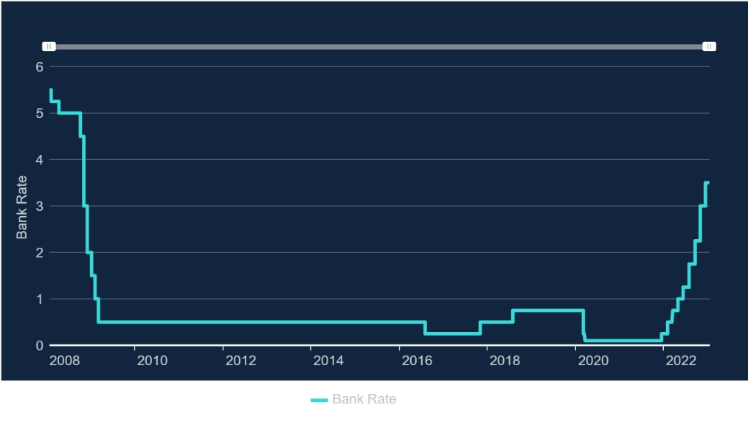


What does the Bank of England do?
Real-Time Gross Settlement
Settled an average of over £720 billion each working day
CHAPS | CREST | BACS | Image Clearing System for cheques | Faster Payments
LINK | Mastercard Europe | Visa Europe | PEXA
RTGS
Notes:
How we’re funded
Public facing
Although we are a public body, we do not get a budget from the UK Treasury. Instead, we generate the funds we need for our work by:
investing the money banks have to hold with us (this is called the 'Cash Ratio Deposit scheme')
charging the firms we regulate a fee
providing banking services to our customers, who include overseas central banks
charging for the cost of producing banknotes
charging a management fee for services we provide to government agencies
investing the capital we have built up over 300 years
The magic behind the curtains
The payments landscape continues to change at a rapid pace, reflecting changes in the needs of households and companies, changes in technology, and an evolving regulatory landscape. The Bank has operated the Real-Time Gross Settlement (RTGS) system since its introduction in 1996. RTGS lies at the heart of every payment in the UK and on average settles over £720 billion on an average day; broadly equivalent to the UK’s GDP every three days. RTGS settled £918 billion on its peak value day (31 January 2022) in the period. Banks and other financial institutions use accounts in RTGS to settle money owed to each other through the UK’s payment systems. The successful management and operation of RTGS directly supports the Bank’s mission to promote the good of the people of the United Kingdom by maintaining monetary and financial stability. As well as providing settlement services, RTGS is also the mechanism through which the Bank implements monetary policy decisions and provides liquidity to the UK’s financial system
In the 12 months to end-February 2022, RTGS settled an average of over £720 billion each working day; broadly equivalent to the UK’s GDP every three days. RTGS settled £918 billion on its peak value day (31 January 2022) in the period. The vast majority of the value settled (99%) is from CHAPS and CREST.
Now and looking into the Future
Due to the level of security around our services and the Bank’s risk-adverse attitude we became very comfortable building and running everything on premise. Our cloud adoption was also stunted by the attitudes of some executives within Technology, but the Bank is now committed to moving 80% of our services to the Cloud by 2030. So moving securely at speed is imperative.

Slide 4







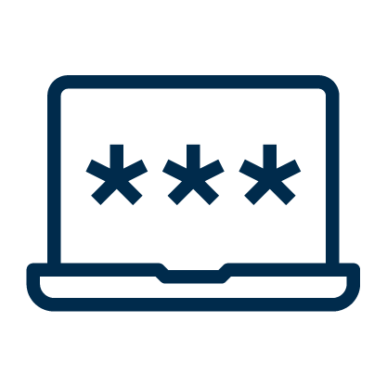


The “Scary” Slide
Notes:
In August 2019, GitHub was called out in a US lawsuit following the Capital One breach. The reason? Allowing social security numbers to be stored in a Git repository.
In October 2019, one misstep from developers at Starbucks left exposed an API key that could be used by an attacker to access internal systems and manipulate the list of authorized users. Lucky the vulnerability was reported as part of a bug bounty program and quickly resolved.
In January 2021, a misconfigured Git server at Nissan North America lead to the leak of the source code of the company's mobile apps and internal tools. A Git server was left publicly exposed with a default username and password of admin/admin.
More recently, in December 2022, Okta reported a breach that included the unauthorised downloading of source code. Access was possible through the use of stolen authorisation keys and could have been related to an extension phishing campaign in September of last year.
While still reading and digesting the information around the Okta breach, a few days later we got news of an attack on Slack. The incident involves threat actors gaining access to Slack's externally hosted GitHub repositories via a "limited" number of Slack employee tokens that were stolen.

Slide 5

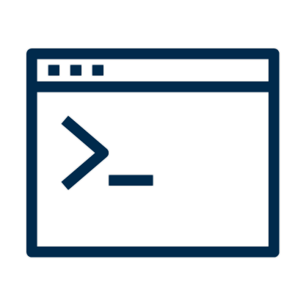

DevOps vs Security – The Perception
Dev
Dev
Sec
Ops
Notes:
Hopefully we all know what good DevOps looks like. Or at least we have read what it is supposed to look like.
Small teams working independently to implement their features, validating correctness in pre-production environments, with deployments into production happening predictably, quickly, safely, and securely, throughout the business day.
But why is reality not like the books? Having worked across multiple roles, I have some strong feelings about this!
As a developer I saw Cyber Security as a blocker to my freedom. It was stopping me using all the tools and code-snippets I found on the internet. I would avoid Cyber people because they were the department of “no”.
As a DevOps lead I saw Cyber as an impediment to innovation. Why couldn’t I have admin rights on every machine within the enterprise so I can run unsigned PowerShell scripts to performed deployments?
As an Ops lead I saw Cyber as the reason my new features were taking so long to reach production.
Finally, as a Cyber Analyst I saw that I was an idiot…. But in my defence, it wasn’t all my fault. Throughout the Technology department Cyber Security and their policies were perceived as obstacles to be worked-around. Their lack of open engagement supported their clandestine reputation.

Slide 6
Title
Dev
Dev
Sec
Ops
Notes:
Hot on the heels of Okta's source code breach, in December we had Slack experiencing a threat actor accessing their repositories using stolen (valid) tokens. Access tokens are an invaluable capability of working with remote services, including GitHub, but as always WE have to be careful as they can expose great power. Simple GitHub access token advice: - store tokens securely (always the first bit of advice in this type of post... don't write them down!) - use fine grained access tokens to enforce the principal of least privilege - create and enforce an expiration policy; the longer they exist, the more damage can be done - tokens don't just give access to code, they can allow access to Actions, so check their capabilities - and finally, understand why the token is needed; not every user or app needs access to repos.

Slide 7



Vince’s Three “i”s of Monitoring in the Cloud
Inventory
Intelligence
Insights
Notes:
Growing number of solutions
47 requirements, but here are 3 of the most important
Inventory
You can’t protect what you can’t see
Agent-based solutions do not guarantee 100% coverage
Created bespoke solution for unknown unknowns
Multi cloud only increases the issue
Should be moving away from traditional VM-based estate
Intelligence
New vulnerabilities have threat actors knocking on our doors
Time to exploit has reduced
Vulnerability data sources widely available, you can do it yourself
Insights
Risks without context are meaningless. Remember that.
CSPs highlight issues in isolation against policies
Is a missing OS patch on a VM that serious?
Following basic security principals provides layers of security
What if game .. Unpatched server … Elevation of Privilege … Pubic IP … poor SSH… lateral move?
Without context possible risk and impact may never be realised
Summary
47 requirements .. A few must haves

Slide 8
Vince’s Three “i”s of Monitoring in the Cloud
Inventory
Intelligence
Insights
Notes:
Hot on the heels of Okta's source code breach, in December we had Slack experiencing a threat actor accessing their repositories using stolen (valid) tokens. Access tokens are an invaluable capability of working with remote services, including GitHub, but as always WE have to be careful as they can expose great power. Simple GitHub access token advice: - store tokens securely (always the first bit of advice in this type of post... don't write them down!) - use fine grained access tokens to enforce the principal of least privilege - create and enforce an expiration policy; the longer they exist, the more damage can be done - tokens don't just give access to code, they can allow access to Actions, so check their capabilities - and finally, understand why the token is needed; not every user or app needs access to repos.

Slide 9

Vince’s Three “i”s of Monitoring in the Cloud
Subject Matter Experts
Business Owners
End Users
Delivery team
People
Success
Requirements capture
Data on-boarding
Feedback
Communications
Development stack
Collaboration tools
Project Tracking Software
Process
Technology
Notes:
Hot on the heels of Okta's source code breach, in December we had Slack experiencing a threat actor accessing their repositories using stolen (valid) tokens. Access tokens are an invaluable capability of working with remote services, including GitHub, but as always WE have to be careful as they can expose great power. Simple GitHub access token advice: - store tokens securely (always the first bit of advice in this type of post... don't write them down!) - use fine grained access tokens to enforce the principal of least privilege - create and enforce an expiration policy; the longer they exist, the more damage can be done - tokens don't just give access to code, they can allow access to Actions, so check their capabilities - and finally, understand why the token is needed; not every user or app needs access to repos.

Slide 10




Notes:
Hot on the heels of Okta's source code breach, in December we had Slack experiencing a threat actor accessing their repositories using stolen (valid) tokens. Access tokens are an invaluable capability of working with remote services, including GitHub, but as always WE have to be careful as they can expose great power. Simple GitHub access token advice: - store tokens securely (always the first bit of advice in this type of post... don't write them down!) - use fine grained access tokens to enforce the principal of least privilege - create and enforce an expiration policy; the longer they exist, the more damage can be done - tokens don't just give access to code, they can allow access to Actions, so check their capabilities - and finally, understand why the token is needed; not every user or app needs access to repos.

Slide 11

Questions?
Vincent King
Head of DevSecOps for Cloud Transformation
DevSecOpsVnce

Slide 12
DevSecOpsVince

